Slide 1
The Pleasures and Perils of Self-Publishing
Eric Roth, Chimayo Press
2014 CATESOL Conference, Santa Clara, California
October 25, 2014

Slide 2
Why do it?
Contributes to the field as teacher & writer
Improves your teaching
Encourages reflection
Share experiences & values
And More!

Slide 3
How do I get started?
Create and sell lessons/chapters as you go.
Field test and collect feedback.
Well begun is half done.

Slide 4
Budget your time…
Writing projects take considerable time – and almost always more than expected.

Slide 5
…And your expenses.
Remember: sometimes you have to spend money to make money.

Slide 6
Choose partnerships carefully.
Who does what?
And When?

Slide 7
Be active on social media.
Create alliances,
and find fans!

Slide 8
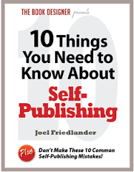
Do your research!
Plus:
Friedlander, Joel. "10 Things You Need to Know About Self-Publishing." The Book Designer. N.p., n.d. Web. Mar. 2016.
(Points 7-10 are exceptionally useful.)
FREE RESOURCE!

Slide 9
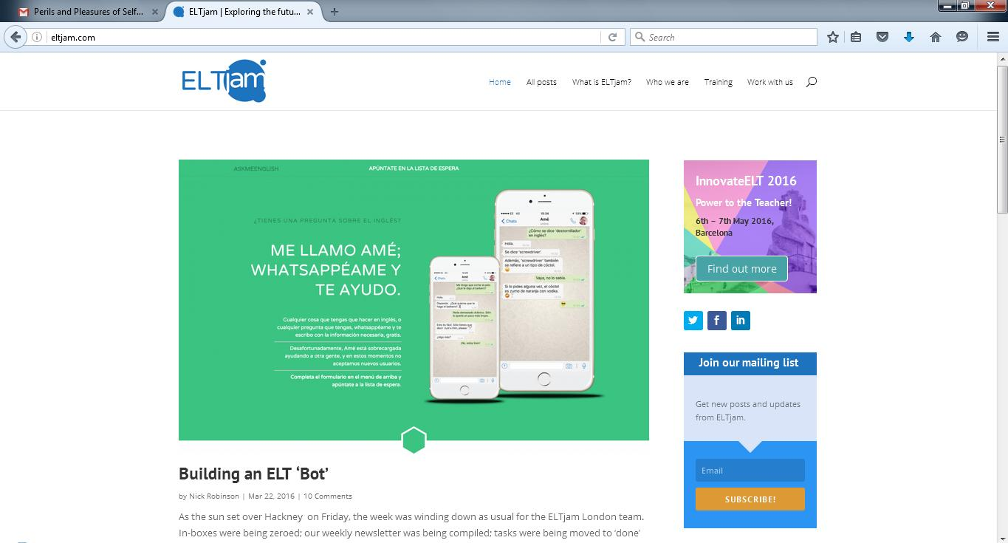
More Resources
Eltjam.com
Eltteacher2writer.co.uk

Slide 10
More Resources
TeachersPayTeachers.com

Slide 11
“Success is going from failure to failure without losing enthusiasm.”
Winston Churchill (1874-1965)

Slide 12
References
Bowerman, Peter. The Well-Fed Self-Publisher: How to Turn One Book into a Full-Time Living. Revised ed. Atlanta, GA: Fanove Pub., 2013. Print.
Lepionka, Mary Ellen. Writing and Developing Your College Textbook: A Comprehensive Guide to Textbook Authorship and Higher Education Publication. 2nd ed. N.p.: Atlantic Path, 2008. Print.
Silverman, Franklin H. Self-Publishing Textbooks and Instructional Materials: A Practical Guide to Successful - And Respectable - Self-Publishing. Gloucester, MA: Atlantic Path Pub., 2004. Print.
Rich, Jason. Self-Publishing for Dummies. Hoboken, N.J: Wiley Pub., 2006. Print.
Eltjam.com
Eltteacher2writer.co.uk
TeachersPayTeachers.com
DollarPhotoClub.com

Slide 13
Thank you!
Questions? Comments?
Contact ericroth@usc.edu

