Slide 1

Eric H. Roth
Master Lecturer
University of
Southern California
Virtual ELT Summit 2020
International Society for Educational Leadership
June 28, 2020
Deploying Search and Share Activities on Zoom

Slide 2
COVID - 19 Shock
- Contingency plan to a week
Week became the semester
Confusing, stressful situation
International students some specific problems in USC
Good mistakes and early blunders
Group class & preserve original tempo
More silence and less laughter
Positive psychology
Less is more
- Added bi-weekly student conferences
.
How can we motivate our English students on Zoom?
1
Notes:
How do we reimagine the. Is online learning a fad? Perhaps. Doubtful

Slide 3
Create More
Micro-lessons
- Speaking
- Writing
- Flexible
Encourage Student Participation
Add more discussion and short writing components
Create new lessons to increase student speech on Zoom
Push, nudge, cajole students to speak
Praise in general (and criticize in particular)
Build rapport and increase motivation
Ask clarifying questions
Develop research skills
Identify knowledge gaps
Use Communicative Methods and Tasks
Assign practical tasks that require collecting information
Learning English is not a spectator sport
Participation remains essential to becoming fluent
2

Slide 4
Feynman Technique of Learning
- Richard Feynman won the 1965 Nobel Prize (Physics)
- Developed for CalTech research assistants
Technique
Pick a topic you want to better understand & start studying
Teach the topic to someone – in clear language
Identify gaps in your knowledge – and fill the gaps
Organize the information and simplify
Search and Share Adaption for ELLs on Zoom
Students pick and study a source
Students teach their classmates in clear language
Students, through discussions, recognize gaps in language and knowledge
Students, in extension activity, organize information (again) and tell a story
3

Slide 5
Which English Class Would You Prefer to Join?
Large lecture hall
40-50 adult English language learners
One teacher at the podium
One source of information
writing resumes and job interviews
Sage on a stage
Large classroom in person and online -
40-50 university English language learners in 10-20 groups
One teacher circulates around the breakrooms
45 students bring and analyze information to class
Small groups of 4-5 students sharing – speaking in Breakout rooms
New discussion group every 15- 20 minutes
Strength Through Diversity of sources and perspectives
Multiple sources; multiple perspectives
- meaningful
- democratic
- interesting
- bespoken
- self-directed
4

Slide 6
What are “Search and Share” Activities?
Simple, flexible technique to turn homework into speaking exercises
Professor still sets the agenda, introduces materials
Professor establishes the particular topic
Worksheets require students to locate, organize material
Students bring relevant, authentic sources to class
Students become hunters and gathers of information
Students must select the material
Students must summarize the content
Students must evaluate the material
Students introduce the material to classmates in small groups
Classmates listen and ask at least one question each
5

Slide 7
Speaking Assignment Examples:
Introducing a Significant Figure in My Field
Advice on Job Interviews
Mock Job Interviews
Podcasts
YouGlish - Pronunciation Advice
Term Definitions
TED Talks
Restaurant review
Product Review
Movie Review
Creating Infographics
Problem-solution presentations
A Significant Trend in My Field
How to Conduct Informational Interviews
Conduct an Informational Interview
ALI 254: Speaking Skills for Academic and Professional Purposes – IV
Also social conversations
Small classes
Many disciplines
3 volunteers
graduate students
2 students left Los Angeles
6

Slide 8

Podcasts
SEARCH -
Search for a podcast
Weekly assignment
Summarize
Evaluate
Share personal interests
How do these activities help start conversations beyond the class?
7

Slide 9
Curated Podcasts
Short
Long
Duration | Title | Description | Link
2-5 minutes | The Academic Minute | Features researchers from colleges and universities around the world | https://www.npr.org/podcasts/564572329/the-academic-minute
5 minutes | That's What They Say | Explores changing language | https://www.npr.org/podcasts/381443663/that-s-what-they-say
5-10 minutes | Conversations from the Corner Office | Brings you inside the room with the business and cultural leaders transforming our economy | https://www.marketplace.org/shows/corner-office-from-marketplace/
6 minutes | 6 Minute English | Topical discussion and new vocabulary | http://www.bbc.co.uk/learningenglish/english/features/6-minute-english
3-10 minutes | Dramas from BBC Learning Englsih | Stories using functional English phrases | http://www.bbc.co.uk/learningenglish/english/features/drama
10 minutes | The Side Hustle School | Talks about how to have a side job | https://sidehustleschool.com/podcasts/
4-10 minutes | This I Believe | First person descriptions of core beliefs | https://www.npr.org/series/4538138/this-i-believe
5-15 minutes | TED Talks Daily | TED talks on the go | https://www.ted.com/about/programs-initiatives/ted-talks/ted-talks-audio

Slide 10
& SHARE
Describe the podcast you chose. Give basic information.
Why did you choose this podcast?
What was the main idea of the podcast segment?
What did you learn listening to the podcast?
How many times did you listen to the podcast? Why?
What was the most interesting part for you? Why?
List and explain five new/interesting vocabulary words, idioms, or expressions you heard from the podcast.
Who is the target audience for this podcast? Why?
How would you rate the podcast on a scale of 1–5, with 5 being the highest? Why?
Are you likely to choose to listen to this podcast again? Why?
9

Slide 11
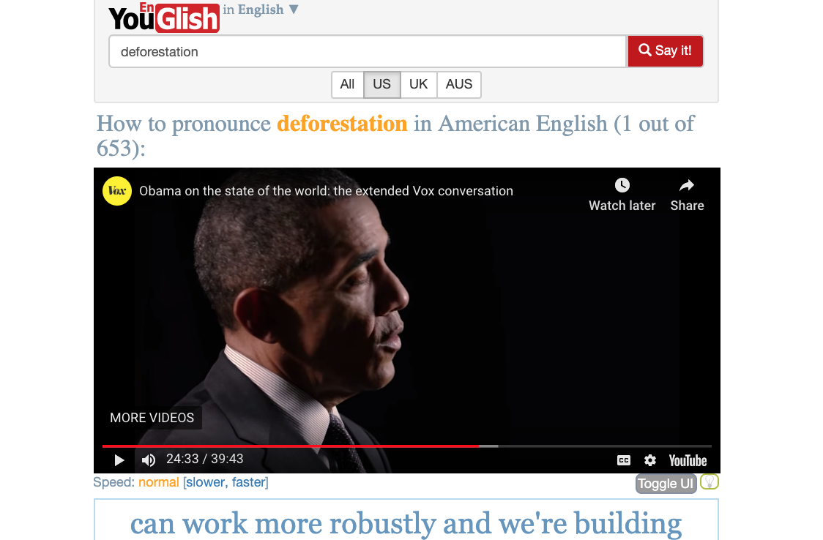
Pronunciation Tips
SEARCH -
What English words do you struggle with?
Search YouGlish for an English word you have trouble pronouncing
Listen to five different native speakers use the word
Read the pronunciation tips
Compare/contrast with similar words
10

Slide 12
& SHARE
What word did you first choose? Why?
What was the first video shown? Who was the speaker?
What pronunciation tips did YouGlish provide for this word?
What were some similar words? List a few.
Which word from your list did you choose to compare with the original word?
What other word did you choose? Why?
What academic term or specialized word did you choose? Why?
Which minimal pair did you choose? Why?
What pronunciation tips did you learn?
How can you use YouGlish to improve your pronunciation?
11

Slide 13
TED Talks: Technology, Entertainment, Design
Contingency assignment
Repeated twice
Flow, the secret to happiness
New insights on poverty
Contingency Lesson Plan
“Riveting talks by remarkable people”
“Ideas worth spreading”
Match student interest and respects their intelligence
Authentic listening material
Highlights global audience for English speakers
Intelligibility, not perfection
Two worksheets
  Definitions
  Problem solutions
12

Slide 14
- Give students choice
- Bought time
- More vocabulary
- Focus on verbs
Who is the speaker? What is the speaker’s background?
Who was the primary audience? Secondary?
How did the speaker begin?
What was the theme? Did it the match the title?
What was the most memorable part? Why?
How did the speaker connect to the audience?
What were five strong verbs used by the speaker?
How successful was the speaker? Why?
How would you rate the TED talk on a scale of 1-5? Why?
Why did you choose this TED talk?
& SHARE
13

Slide 15
ALI 255: Academic and Professional Writing IV
Writing Assignment Examples:
Self-introduction and biostatement
Describing Your Hometown (with map)
Academic Integrity and Understanding Plagiarism
Advice on Writing Resumes and Cover Letters
Creating a Professional Profile on ConnectSC and/or LinkedIn
Reaction paper – Dr. King’s “Letter from a Birmingham Jail”
Comparative Essay
Illumin: A Review of Engineering in Everyday Life
Restaurant Review - Yelp
Product Review - Amazon
Movie Review – IMDB/ metacritic
Annotated Bibliography
Identify a Significant Trend in Your Field
Write a Data Commentary – Infographic/Graph/Chart
A Significant Problem in My Country/Field
Creating an Annotated Bibliography
Research Paper
Mostly graduate students
14 students
10 countries
12 fields
3 hours a week
2 volunteers
5 returned to their country
14

Slide 16

Languages
SEARCH -
What world languages are you curious about?
Search Wikipedia for more information about another language and take notes
How can a mother language/ first language interfere with learning English?
15

Slide 17
& SHARE
What language did you choose to study today? Why did you pick it?
Where is this language usually spoken? How many people, approximately, speak it?
Can you tell me a bit more about this language?
4. Is this language an official language? Where?
5. Is this an ancient or modern language? How do you know?
What are five words that English borrows from this language?
Who are some famous people who speak this language?
What music or movies are created in this language? Can you give some examples?
How similar is this language to English? In what ways?
In what situations would knowing how to speak this language be helpful?
16

Slide 18
Illumin: A Review of Engineering in Everyday Life
Award winning website written and edited by USC Viterbi School of Engineering students (undergraduates)
Used by many high schools, community colleges, and universities
Celebrates science and technology
Illumin
the-algorithm-behind-plane-ticket-prices-and-how-to-get-the-best-deal/
Leonardo da vinci the engineer
to-hear-or-not-to-hear/
Bamboo
Healthy Themes emerge:
Dates matter
Technologies evolve
Some big ideas fail
But engineering and science makes our life better
Illumin
illumin.usc.edu
Contingency lesson
Build professional identity
Celebrate engineering
Progress
17

Slide 19
& SHARE
What’s the main idea of the article?
How many sources does the author cite? What is the most recent source?
What kind of illustrations are used in the article?
What is the strongest feature of the article?
Select five vocabulary words, idioms, or phrases of note:
What did you learn from this article?
Why did you choose this article?
How would you rate the article on a scale of 1-5? Why?
Which field of engineering interests you the most? Why?
Can you select another object/technology/procedure and show how it has improved in the last decade?
A.
B.
C.
D.
E.
18

Slide 20
Students
Identify audience
Highlight strengths
Note limits/weak points
Compare to other sources
Share evaluations (fair, balanced, nuanced?)
Develop critical thinking skills
Increase comfort with academic vocabulary
Contribute to review sites
Collect and reflect?
Move from 1st person to third person
Building critical skills in authentic contexts
19

Slide 21

Restaurants
SEARCH -
Can you recommend a local restaurant?
Choose your favorite spots to grab breakfast, lunch, or a dinner
Search the reviews on Yelp to see what others are saying
Combine both facts and opinions
Rate 1-5 stars
20

Slide 22
& SHARE
What is the name of the restaurant? How far is it from here?
Can you tell me a bit about the restaurant?
Is this establishment part of a chain or independently owned?
What is the price range for menu items? How much will a meal probably cost?
Which menu item is this place’s “claim to fame?”
What menu item do you order most frequently here? Do you have a favorite dish?
Why do you recommend this place? What makes it special?
Name one advantage this restaurant has over competitors.
Who do you think would enjoy a meal here?
Does the average Yelp rating for this place fit your experience there? Why?
21

Slide 23

Consumer Products
SEARCH -
How would you rate your favorite appliance?
Research the product online (at least two sources)
Create a product review
Numbers add precision
Pay attention to word forms – wide, vs. width vs. widen
– Weigh vs. weight
22

Slide 24
& SHARE
What’s the product? Do you own the product?
What is the purpose of the product?
Who is the target audience for this product? Who usually uses it?
How is the product used?
What is the best feature of this consumer product?
What competitors does the product have? Does this product have a competitive advantage?
Are there some possible dangers or misuses of the product?
What did you learn from your research about this product?
Would you recommend this product to your classmates? Do you have some concerns about this product?
How would do you rate the product on a scale of 1–5, with 5 being the highest? Why?
23

Slide 25


Movies
SEARCH -
Can you recommend a good movie?
What’s your favorite movie?
Research your favorite film on imdb.com or metacritic.com
What do the critics have to say?
Include a quote and cite an illustration
Watch verb tense
24
Notes:
https://www.imdb.com/title/tt3783958/?ref_=nv_sr_srsg_0
Or add 3 posters: La La Land, 3 Idiots, Joker

Slide 26
& SHARE
Where and when does the movie take place?
Who is the main character? Can you briefly describe another important character?
What happens in the movie?
What is the best part? Why?
Does the movie surprise the audience? How?
Who do you think would like this movie? Why?
Can you compare this movie to another film? What’s the relationship?
How could the movie be better?
How would you rate the movie on a scale of 1–5, with 5 being the highest? Why?
Can you choose five adjectives to describe this movie? Why?
25

Slide 27
How Do Students Practice Sharing Information?
Three before Me (from HigherEdtech Podcast)
  Ask a question to student, Google, YouTube
  Question and three key words
introduce material of their own choice
Consider audience
Lead academic discussions
Share personal interests
Share opinions and experiences
Support their opinions with examples
Ask clarifying questions
Answer peer questions
Build stronger personal relationships
Experience some success in communicating in English
Gain more recognition for their developing expertise
Become co-creators of course content
Build fluency skills in English classrooms
Becoming better speakers & writers in English
June 28, 2020
26

Slide 28
Summarizing
Evaluatin
Sharing
Stepping stone
LMS posts
Longer assignments
Personal research
Provide basic information for written/video sources
Author/publication/date
Can add length, illustrations, number of sources
Identify the main idea
Use distancing phrases: “According to” “The author notes”
Use reminder phrases: “The host also suggests”
“the article concludes”
Develops research skills & cite information
Observe structure, vocabulary, and style of articles
Identify facts and opinions
Expand working vocabulary
Re-enforces academic and professional skills
Stand alone or stepping stone
Individualized feedback in conferences
27

Slide 29

Birthdays
SEARCH -
What was happening in the world you were born?
How has the world changed?
Search online or interview a relative
Collect and reflect
28

Slide 30
& SHARE
Where were you born? Describe the place where you were born.
Who was present at your birth?
How did your birth change your family?
4. What were some major news stories when you were born?
5. What songs were popular when you were born?
What were some popular movies that year?
Who are some famous people who share your birthday?
How do you typically celebrate birthdays?
What do you want to do in the next year? Why?
What has been the best year of your life so far? Why?
29

Slide 31

Culture Shock
SEARCH -
What is culture shock?
What advice can you find on adjusting to a new culture?
Search online for a video about culture shock
Is staying at home during COVID-19 a form of culture shock?
30

Slide 32
& SHARE
How does the video you chose describe culture shock?
Is there more than one kind of culture shock? Explain.
According to the video, how long does culture shock typically last?
List five tips for overcoming culture shock provided in the video.
What do you appreciate about being in the United States?
What do you find uncomfortable about American culture?
What are some ways that American culture is different from yours?
How would you rate the video on a scale of 1–5, with 5 being the highest? Why?
Have you experienced culture shock? In what ways?
What advice would you offer an international student coming to the U.S. for a year?
31

Slide 33
Some benefits
Flexible
Popular
Stepping stone
Classroom ritual
Warm up exercise on Zoom
Uses breakout rooms – rotate members
Multiple levels
Supplemental Assignments
Core lesson
10-120 minutes of class work
Can be used in English classrooms – speaking and writing
Can be used in many academic high school, community college, university, and graduate courses
Can be used in and across multiple disciplines
Deepens their academic and professional identities
Students learn by doing
Students expand their working vocabulary
Graded or ungraded
Students have very positive English language experiences
32
Notes:
Students develop speaking, listening, and writing skills
Students expand their working vocabulary
Students learn by doing
Students can work in pairs or small discussion groups
Students often have very positive English language experiences

Slide 34
Thank you!
Recommended Sites
www.Educause.edu
www.Edutopia.org
English Proficiency Index. http://www.ef.com/epi/downloads/
www.Glassdoor.com
http://thehigheredtechpodcast.com/
www.Illumin.usc.edu
http://www.imdb.com
www.worldindata.com
www.YouGlish.com
www.compellingconversations.com/worksheets.php
“Gratitude is the memory of the heart.” - French proverb
Virtual ELTSummit
International Society for Education Leadership
PP Savani University
ELT@I – Ahmedabad chapter ELT@I - Pune Chapter
Tarun Patel
Laurie A. Selik
Teresa X. Nguyen
USC Students – ALI 254
USC Students – ALI 255
American Language Institute – University of Southern California
33

Slide 35



THANK YOU!
Eric H. Roth, M.A.
Master Lecturer,
University of Southern California
American Language Institute ericroth@usc.edu eric@compellingconversations.com
34

Slide 36
‘Search and Share’ Works in ELL Classrooms
Students Speak More English in Class
Count the minutes
Learn by doing
Creates positive, authentic communication experiences
Students Bring More Enthusiasm to Class
More students complete the homework
Students hold lively discussions
Students Feel Heard and Understood
Course evaluations consistently very positive
Students often express gratitude
Results?
35

Slide 37
What Does the English Teacher Do ?
Teacher can circulates between breakout rooms taking notes
Teachers can join in the small group discussions
Teachers can videotape student discussions (choice)
Teachers can review and evaluate worksheets on Google Docs
Teachers can ask for links/copies of original materials
Students can post links and answers to LMS Discussion board/blog
Teachers can join the online discussion, monitor student comments, and evaluate the online contributions and comments
Teachers can still grade and provide written and oral feedback
Or teachers can focus on grading the final product (presentation/paper)
Can follow up in student-professor conferences
More privacy?
What does the English teacher do?
36

Slide 38
Search and Share Activities Address Essential ELL Classroom Challenges –
Allows students to develop personal learning interests
Allows ELLs to replay lectures numerous times
Helps individualize instruction
New Twist on Old Homework Challenges
Audio and video records go beyond the printed word
Introduces materials and concepts off campus
Repackages homework for 21st century students
Technology Opens New Classroom Possibilities
Allows students to bring their questions
Encourages students to identify and often solve problems in class
Requires more student participation in small groups
Opens up collaborative learning and communicative tasks
Conclusions
37

