Slide 1


Giving Students a Choice and a Voice
Eric H. Roth, University of Southern California
September 6, 2019

Slide 2

Icebreakers
SEARCH_
Search for a video on YouTube about icebreaker (or ice breaker) activities
How do these activities help start conversations?
Intercultural Communications College
1
September 6, 2019

Slide 3
& SHARE
Describe the video you chose. In what context are these people being introduced?
Name one icebreaker that was featured in the video you chose.
Have you used this icebreaker before? Was it useful?
What opinions are expressed in the video?
What did you learn from watching this video?
What was the most interesting part for you? Why?
Write five new vocabulary words, idioms, or expressions related to the topic.
Why did you choose this video?
How would you rate the article on a scale of 1–5, with 5 being the highest? Why?
What is your favorite question to start conversations with? Why?
Intercultural Communications College
2
September 6, 2019

Slide 4
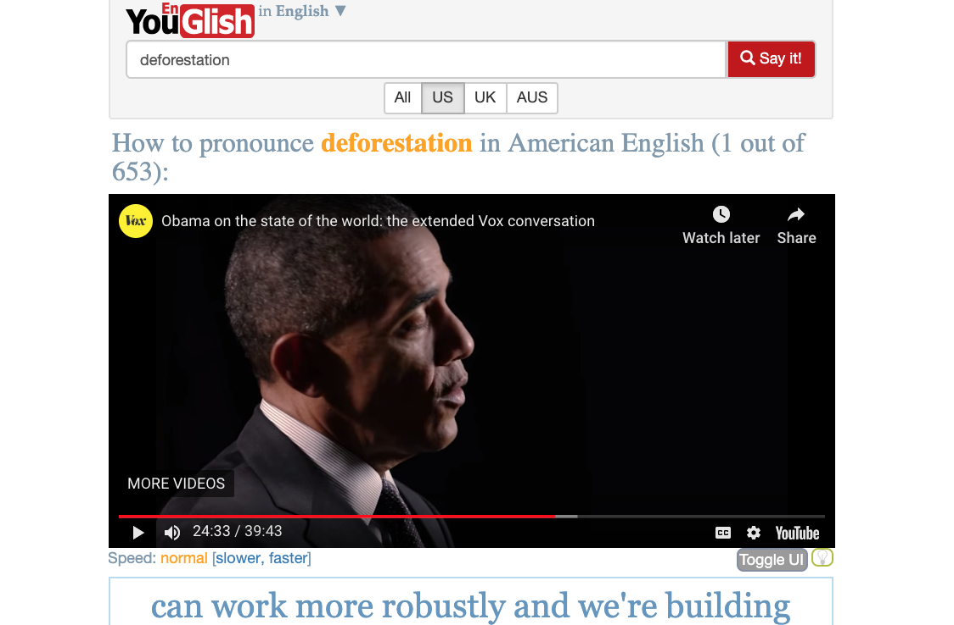
Pronunciation Tips
SEARCH_
What English words do you struggle with?
Search YouGlish for an English word you have trouble pronouncing
Listen to five different native speakers use the word
Read the pronunciation tips
Compare similar words
Intercultural Communications College
3
September 6, 2019

Slide 5
& SHARE
What word did you first choose? Why?
What was the first video shown? Who was the speaker?
What pronunciation tips did YouGlish provide for this word?
What were some similar words? List a few.
Which word from your list did you choose to compare with the original word?
What phrase did you choose? Why?
What academic term or specialized word did you choose? Why?
Which minimal pair did you choose? Why?
What pronunciation tips did you learn?
How can you use YouGlish to improve your pronunciation?
Intercultural Communications College
4
September 6, 2019

Slide 6
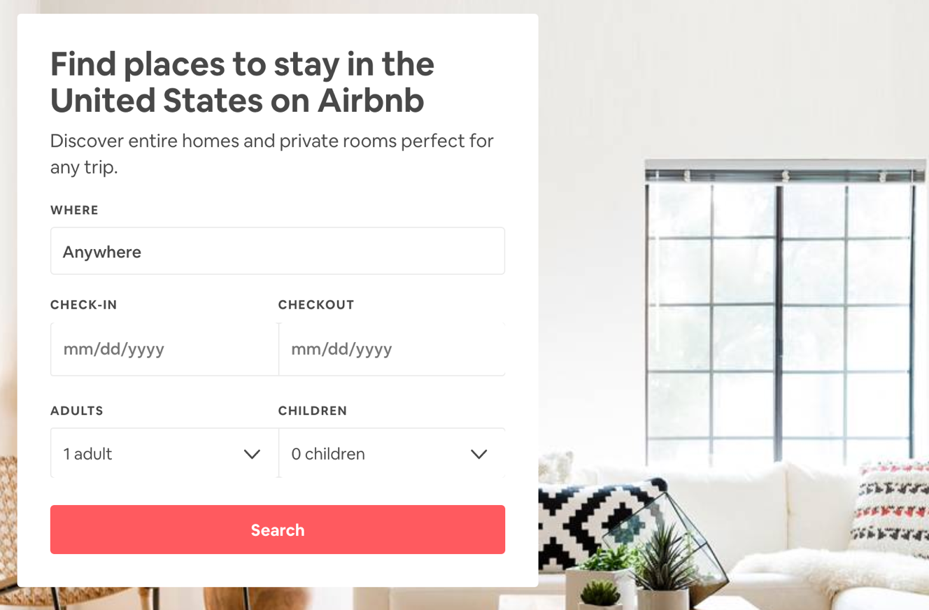
Dream Homes
SEARCH_
Where is your dream vacation home?
Visit airbnb.com
Choose your dream vacation destination
Search for available homes that fit your style
Intercultural Communications College
5
September 6, 2019

Slide 7
& SHARE
What does the outside of your dream vacation home look like?
How would you describe the area? (Search Google Maps for the neighborhood.)
What does the inside of your dream vacation home look like?
Describe your favorite room.
How is your favorite room decorated?
6 What else makes this home special?
What activities will you do on this vacation?
What other information can you share about your fantasy vacation?
Who will stay with you in your dream vacation home? Why?
What five adjectives describe your dream vacation home?
Intercultural Communications College
6
September 6, 2019

Slide 8

Pets
SEARCH_
Search for an informative article about caring for pets
What makes a good pet?
What makes a good owner?
Intercultural Communications College
7
September 6, 2019

Slide 9
& SHARE
Provide a brief summary of the article you chose. What was the main idea?
Why did you choose this article?
What is the author’s opinion on pets?
Which ideas from the article/video do you agree with? Why?
Identify five verbs in the article.
What do you like the most about the article?
How could the article be improved?
How would you rate the article on a scale of 1–5, with 5 being the highest? Why?
What do you look for in pets?
What advice can you share with a new pet owner?
Intercultural Communications College
8
September 6, 2019

Slide 10

Birthdays
SEARCH_
What was the world like the day you were born?
How has it changed?
Search online or interview a relative
Intercultural Communications College
9
September 6, 2019

Slide 11
& SHARE
Where were you born? Describe the place where you were born.
Who was present at your birth?
What were some surprises surrounding your birth?
What was happening in the world when you were born? What were some major news stories at this time?
What songs were popular when you were born?
What were some popular movies that year?
Who are some famous people who share your birthday?
Who do you typically celebrate your birthday with? Why?
Do you have any special plans to celebrate your next birthday? Why?
What has been the best year of your life so far? Why?
Intercultural Communications College
10
September 6, 2019

Slide 12

Culture Shock
SEARCH_
What is culture shock?
What advice can you find on adjusting to a new culture?
Search online for a video about culture shock
Intercultural Communications College
11
September 6, 2019

Slide 13
& SHARE
How does the video you chose describe culture shock?
Is there more than one kind of culture shock? Explain.
According to the video, how long does culture shock typically last?
List five tips for overcoming culture shock provided in the video.
What do you appreciate about being in the United States?
What do you find uncomfortable about American culture?
What are some ways that American culture is different from yours?
How would you rate the video on a scale of 1–5, with 5 being the highest? Why?
Have you experienced culture shock? In what ways?
What advice would you offer an international student coming to the U.S. for a year?
Intercultural Communications College
12
September 6, 2019

Slide 14
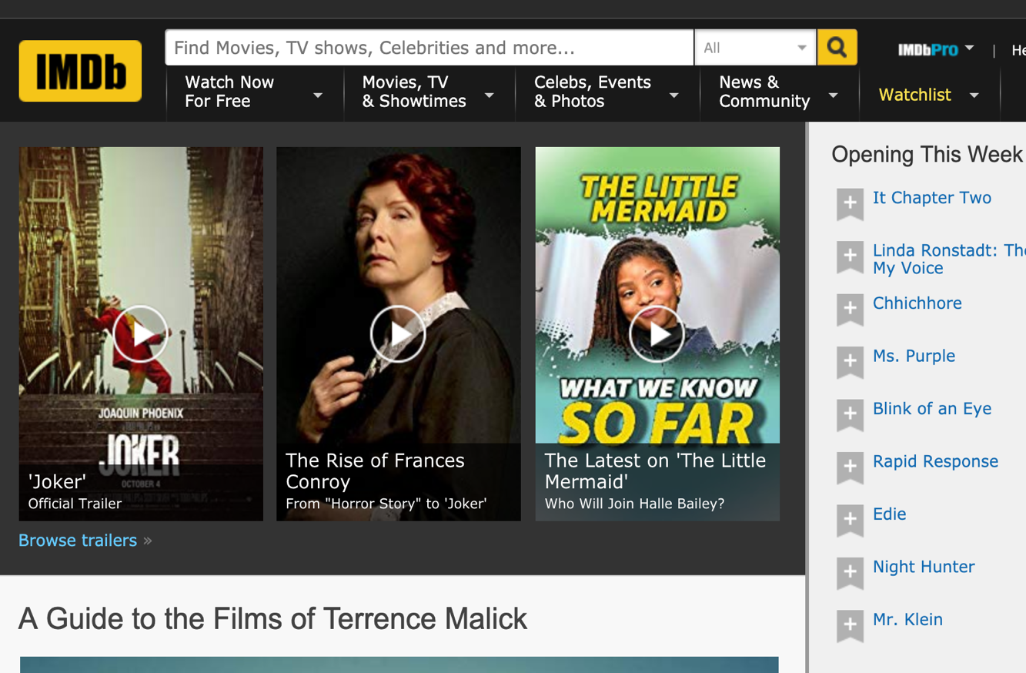
Movies
SEARCH_
What’s your favorite movie?
Research your favorite film on imdb.com or metacritic.com
What do the critics have to say?
Intercultural Communications College
13
September 6, 2019

Slide 15
& SHARE
Where and when does the movie take place?
Who is the main character? Can you briefly describe another important character?
What happens in the movie?
What is the best part? Why?
Does the movie surprise the audience? How?
Who do you think would like this movie?
How could the movie be better?
How would you rate the movie on a scale of 1–5, with 5 being the highest? Why?
Can you choose five adjectives to describe this movie? Why?
Intercultural Communications College
14
September 6, 2019

Slide 16

Consumer Products
SEARCH_
How would you rate your favorite appliance?
Research the product online (at least two sources)
Create a product review
Intercultural Communications College
15
September 6, 2019

Slide 17
& SHARE
Do you own the product?
What is the purpose of the product?
Who is the target audience for this product? Who usually uses it?
How is the product used?
What is the best feature of this consumer product?
What competitors does the product have? Does this product have a competitive advantage?
Are there some possible dangers or misuses of the product?
What did you learn from your research about this product?
Would you recommend this product to your classmates? or why not? Do you have some concerns about this product?
How would do you rate the product on a scale of 1–5, with 5 being the highest? Why?
Intercultural Communications College
16
September 6, 2019

Slide 18

Languages
SEARCH_
What world languages are you curious about?
Search Wikipedia for more information about another language and take notes
Intercultural Communications College
17
September 6, 2019

Slide 19
& SHARE
What language did you choose to study today? Why did you pick it?
Where is this language usually spoken? How many people, approximately, speak it?
Can you tell me a bit more about this language?
Where is this language an official language?
Is this an ancient or modern language? How do you know?
What are five words that English borrows from this language?
Who are some famous people who speak this language?
What music or movies are created in this language? Can you give some examples?
How similar is this language to English? In what ways?
In what situations would knowing how to speak this language be helpful?
Intercultural Communications College
18
September 6, 2019

Slide 20
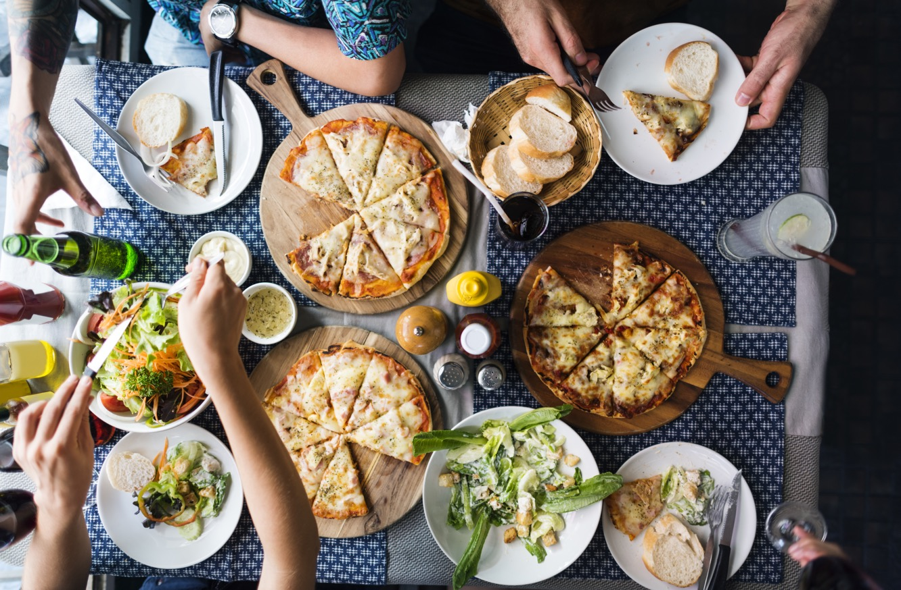
Restaurants
SEARCH_
Where can you grab the best food in your area?
Choose your favorite spots to grab breakfast, pizza, and an ethnic cuisine of your choice
Search the reviews on Yelp to see what others are saying
Intercultural Communications College
19
September 6, 2019

Slide 21
& SHARE
What is the name of the restaurant?
How long has it been in business?
Is this establishment part of a chain or independently owned?
What is the average price of a meal at this establishment?
What menu item is this place’s “claim to fame?”
What menu item do you order most frequently here? Do you have a “usual?”
Why do you recommend this place? What makes it special?
Name one advantage this eatery has over competitors.
Name one disadvantage this eatery has over competitors.
Does the average Yelp rating for this place fit your experience there? Why?
Intercultural Communications College
20
September 6, 2019

Slide 22



THANK YOU!
Eric H. Roth, M.A.
Master Lecturer, USC ALI eric@compellingconversations.com
Intercultural Communications College
21
September 6, 2019

Slide 23
Title
SEARCH_
Insert Text
Intercultural Communications College
22
September 6, 2019

Slide 24
& SHARE
Insert list items 1-5
Insert list items 6-10
Intercultural Communications College
23
September 6, 2019

Slide 25
Title
Intercultural Communications College
24
September 6, 2019

Slide 26
Title
Intercultural Communications College
25
September 6, 2019

Slide 27
Title
Intercultural Communications College
26
September 6, 2019

Slide 28
Title
Intercultural Communications College
27
September 6, 2019

Slide 29
Title
Intercultural Communications College
28
September 6, 2019

