Slide 1
A Reflective Introduction to
American Culture
Eric H. Roth, M.A.
Master Lecturer
Jim Valentine, Ph.D.
Director
American Language Institute
August 14, 2017

Slide 2
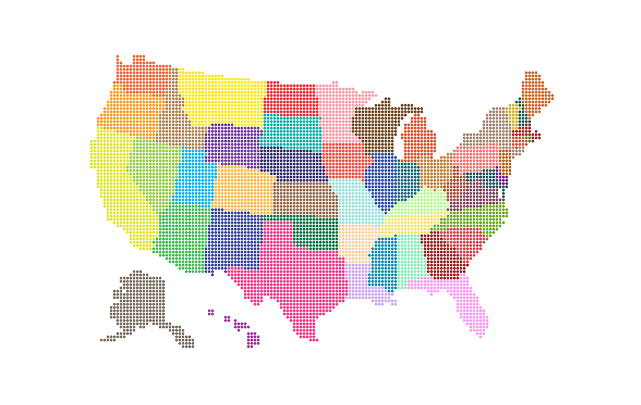
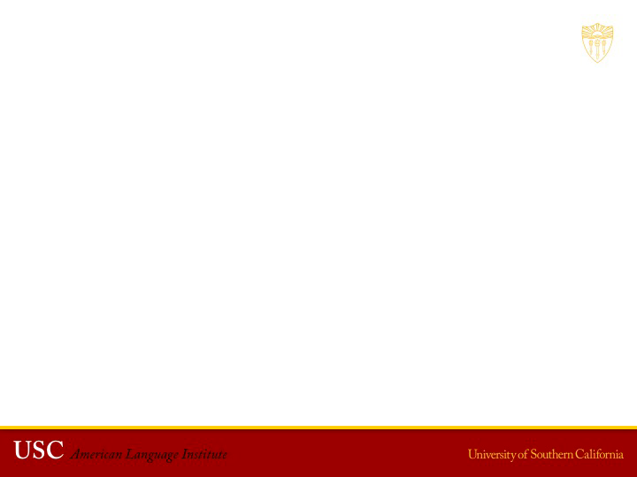
“The past is never dead. It’s not even the past.”
-William Faulkner, (1897-1962) American writer and Nobel Prize recipient

Slide 3
Removal of Robert E. Lee Statue in New Orleans, LA
1

Slide 4
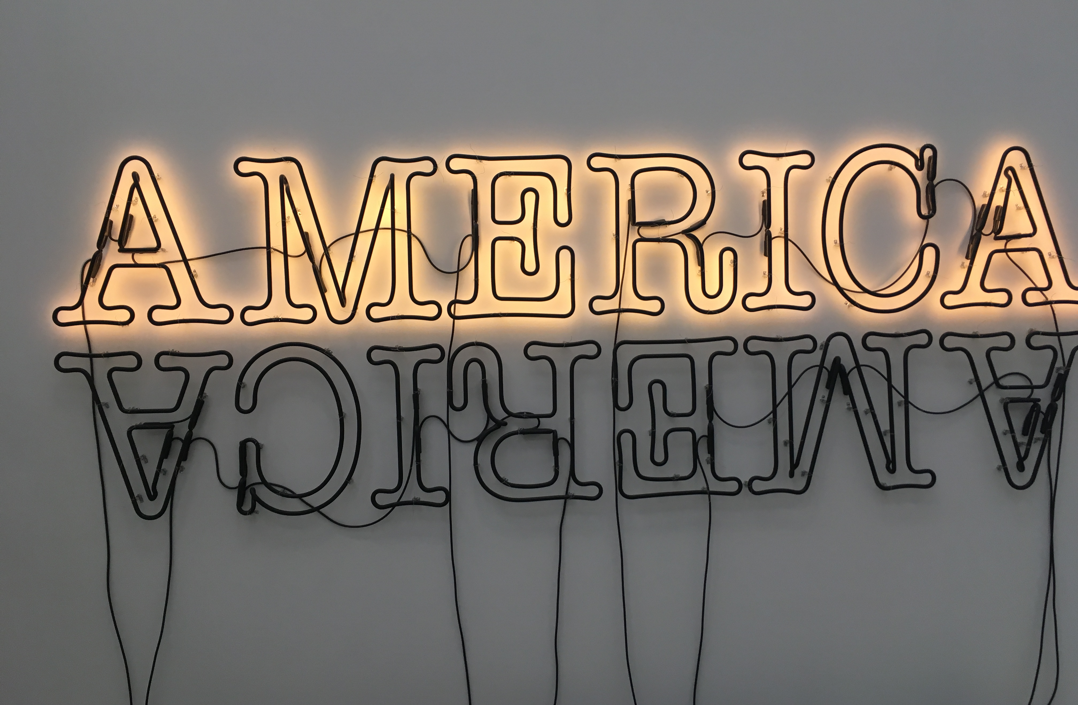
Double America 2 (2014), Glenn Ligon, American artist
2

Slide 5
Who are we?
“To literally put the Confederacy on a pedestal in our most prominent places of honor is an inaccurate recitation of our full past, it is an affront to our present, and it is a bad prescription for our future. History cannot be changed. It cannot be moved like a statue. What is done is done. The Civil War is over, and the Confederacy lost and we are better for it.”
- Mitch Landrieu, Mayor of New Orleans
3
4
Exploring American Culture, August 14, 2017

Slide 6
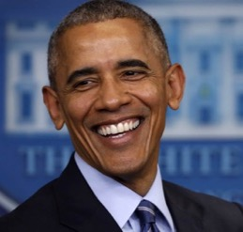
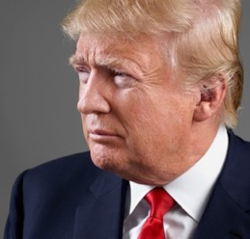
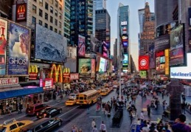
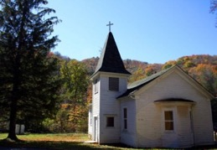
What is American Culture?
People: Obama, Simone Biles, Kobe Bryant, Trump, Steve Jobs, Angelina Jolie
Places: Times Square, Statue of Liberty, Silicon Valley, basketball court, small town church
Things: basketball, hamburger, apple pie, smart phone, campus, huge house (McMansion)
5
6
7
8
9
Exploring American Culture, August 14, 2017

Slide 7
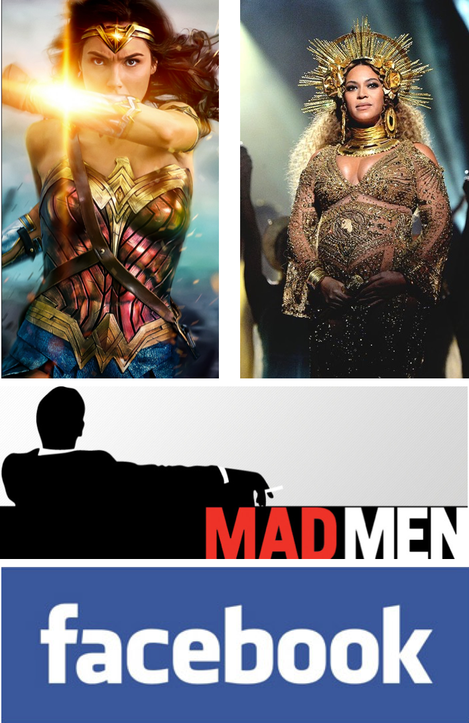
What is American Culture?
POSSIBLE ANSWERS:
Pop Culture
Movies
Music
TV
Social media
10
11
12
13
Exploring American Culture, August 14, 2017
Notes:
Images don’t appear

Slide 8
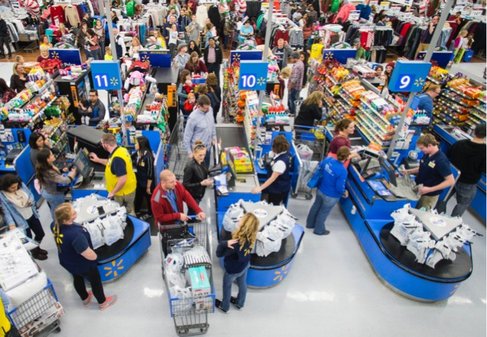
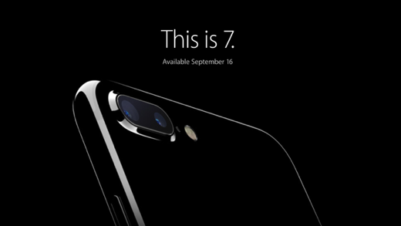
What is American Culture?
POSSIBLE ANSWERS:
Consumerism
“You are what you own”
Constant recreation of self
Democratic
Cult of self-expression
14
15
Exploring American Culture, August 14, 2017
Notes:
Top images doesn’t appear

Slide 9

What is American Culture?
POSSIBLE ANSWERS:
Diversity
Racial
Religious
Family
Gender
16
17
Exploring American Culture, August 14, 2017
Notes:
Images are way too small and in the corners. Let’s resize to fill the space.

Slide 10
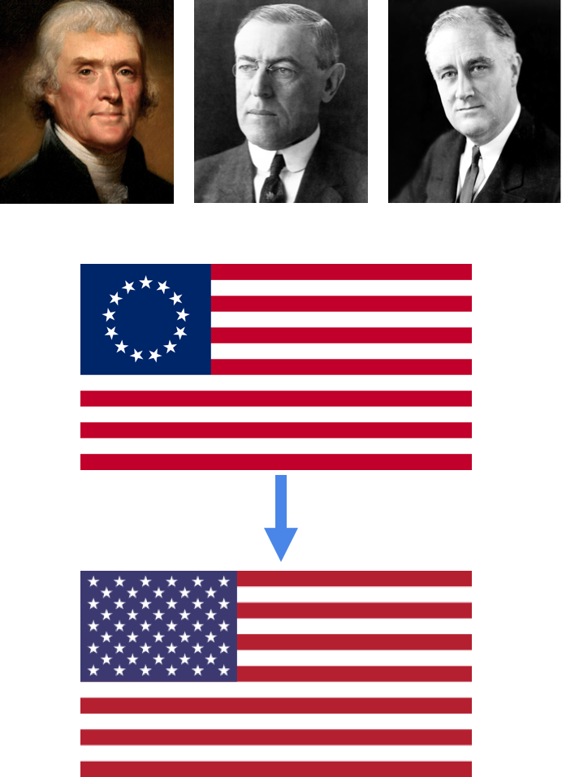
What is American Culture?
POSSIBLE ANSWERS:
Exceptionalism
Global superpower
Washington’s Farewell Address
War to Make the World Safe for Democracy
Pearl Harbor & 9/11
18
19
20
Exploring American Culture, August 14, 2017
Notes:
Images way, way too small. Delete top three images.
Can we resize so the first flag so it is more visible?
two flags…. 13 to 50 stars
Jefferson quote in the middle.

Slide 11
What is American Culture?
POSSIBLE ANSWERS:
Universalist claims
America as an idea
UN Declaration of Human Rights
Not blood and soil nationalism
We are the world
21
22
“The world is my country; all mankind are my brethren, and to do good is my religion.”
– Thomas Paine, (1737-1809) American revolutionary, philosopher and political activist
Exploring American Culture, August 14, 2017
Notes:
Can we number this #5?

Slide 12
What are Core American Values?
POSSIBLE ANSWERS:
Individualism
“In America, nobody says you have to keep circumstances somebody else gives you.”
Amy Tan (1952- ), Chinese-American novelist
23
24
25
Exploring American Culture, August 14, 2017

Slide 13
What are Core American Values?
POSSIBLE ANSWERS:
Deep Optimism
“American Dream” - every generation enjoys a higher quality of life
  coined 1931 by James Truslow Adams (1878-1949), American popular historian (unrelated to the Massachusetts Adamses), in Epic of America.
The belief that the American social, economic, and political system makes success possible for every individual big house, three cars, two children
26
"We hold these truths to be self-evident, that all men are created equal, that they are endowed by their Creator with certain unalienable Rights, that among these are Life, Liberty and the pursuit of Happiness”
– Thomas Jefferson, Declaration of Independence
* * *
Exploring American Culture, August 14, 2017

Slide 14
What are Core American Values?
POSSIBLE ANSWERS:
City on a Hill
Lead by example
Make America Great
27
“I must study Politicks and War that my sons have liberty to study Mathematicks and Philosophy. My sons ought to study mathematicks and philosophy, geography, natural history, naval architecture, navigation, commerce and agriculture, in order to give their children a riht to study painting, poetry, musick, architecture, statuarty, tapestry and porcelaine"
– John Adams, letter to Abigail Adams, May 12, 1780*
*spelling in American English has changed since 1780
Exploring American Culture, August 14, 2017

Slide 15
What are Core American Values?
POSSIBLE ANSWERS:
Tradition of Liberty
Freedom to vs. freedom from
Core documents
Mayflower Compact
Constitution
Bill of Rights
Gettysburg Address
28
“We shall nobly save or meanly lose the last best hope of earth.”
– Abraham Lincoln, Gettysburg Address, Dec. 1, 1862
* * *
“. . . these presents, solemnly and mutually, in the presence of God, and one another, covenant and combine ourselves together into a civil body politic. . . and by virtue hereof to enact, constitute, and frame, such just and equal laws, ordinances, acts, constitutions, and offices, from time to time, as shall be thought most meet and convenient for the general good of the colony; unto which we promise all due submission and obedience.”
– Excerpt from the Mayflower Compact, Nov. 11, 1620
Exploring American Culture, August 14, 2017

Slide 16
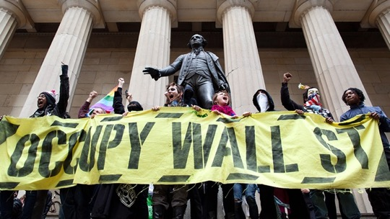
What are Core American Values?
POSSIBLE ANSWERS:
Bill of Rights
Freedom of speech
Freedom of Assembly
Freedom of religion
Freedom to stay silent
Right to trial by jury
29
30
Exploring American Culture, August 14, 2017

Slide 17
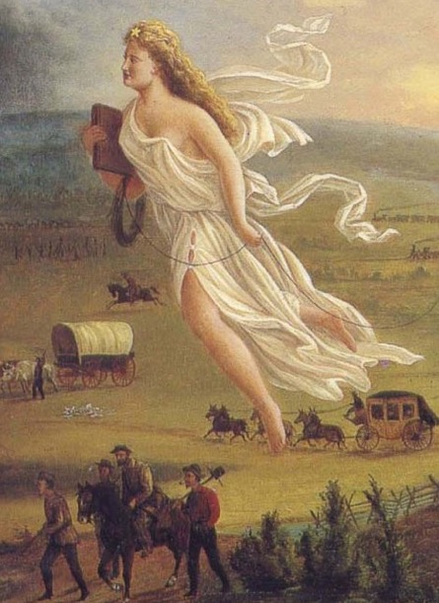
What are Core American Values?
POSSIBLE ANSWERS:
Frontier consciousness
Manifest Destiny
Empty land myth
Amazon motto: Work hard, have fun, make history
Space: the last frontier
    “The land belongs to the future.” – Willa Cather
31
32
Exploring American Culture, August 14, 2017

Slide 18
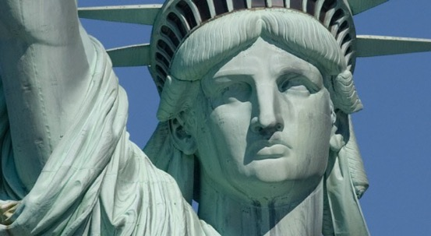
What are Core American Values?
POSSIBLE ANSWERS:
Immigration and Science
Alien and Sedition Acts (1798)
Immigration and Naturalization Acts
1790, 1924, 1965
Chinese Exclusion Act (1882)
Immigration Reform and Control Act of 1986
33
34
35
“Give me your tired, your poor, / Your huddled masses yearning to breathe free, / The wretched refuse of your teeming shore. / Send these, the homeless, tempest-tossed, to me: / I lift my lamp beside the golden door.”
– Emma Lazarus, inscription on the base of the Statue of Liberty
Exploring American Culture, August 14, 2017

Slide 19
Toward a More Perfect Union
Obama’s speech: https://en.wikipedia.org/wiki/A_More_Perfect_Union_%28speech%29
"We the people, in order to form a more perfect union." Preamble to U.S. Constitution
"in no other country on Earth is my story even possible"
"to continue the long march of those who came before us, a march for a more just, more equal, more free, more caring and more prosperous America."
36
Exploring American Culture, August 14, 2017

Slide 20
Toward a More
Perfect Union
O, yes, / I say it plain, / America never was America to me, / And yet I swear this oath— / America will be!
Out of the rack and ruin of our gangster death, / The rape and rot of graft, and stealth, and lies, / We, the people, must redeem / The land, the mines, the plants, the rivers. / The mountains and the endless plain— / All, all the stretch of these great green states— / And make America again!
—Langston Hughes, Let American Be America Again (1994) via https://www.poets.org/poetsorg/poem/let-america-be-america-again
Exploring American Culture, August 14, 2017

Slide 21
What is the “Ugly American?”
POSSIBLE ANSWERS:
Materialistic
Vulgar
Arrogant
Excessive/Limitless
Ignorant
“Experience has shown, that even under the best forms of government, those entrusted with power have, in time, and by slow operations, perverted it into tyranny.”
– Thomas Jefferson, letter to James Madison
37
38
39
Exploring American Culture, August 14, 2017

Slide 22
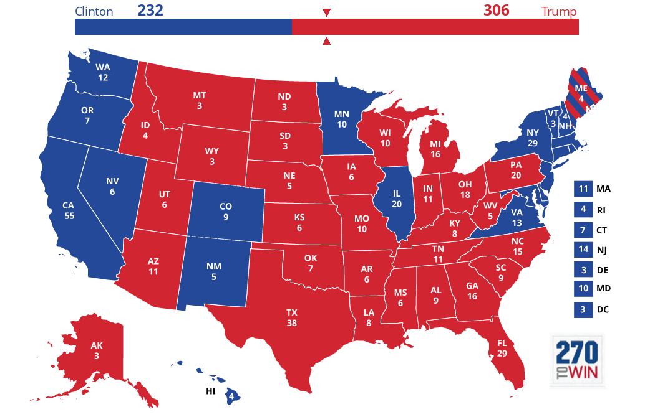
Is the American Dream outdated?
Challenge of 9/11
Economic stress
Trump challenge: Make America Great Again
Patriotism or nationalism?
40
Exploring American Culture, August 14, 2017

Slide 23
Is the American
Dream outdated?
You making haste haste on decay: not blameworthy; life is good, be it stub-
bornly long or suddenly
A mortal splendor: meteors are not needed less than mountains:
shine, perishing republic.
But for my children, I would have them keep their distance from the thick-
ening center; corruption
Never has been compulsory, when the cities lie at the monster's feet there
are left the mountains.
And boys, be in nothing so moderate as in love of man, a clever servant,
insufferable master.
There is the trap that catches noblest spirits, that caught--they say--
God, when he walked on earth.
—Robinson Jeffers, Shine, Perishing Republic (1936) via https://www.poemhunter.com/poem/shine-perishing-republic/
Exploring American Culture, August 14, 2017

Slide 24
Books of Potential Interest on American Culture
American Vertigo: Traveling America in the Footsteps of Tocqueville by Bernard-Henri Lévy. Translated by Charlotte Mendel. Random House. 2006.
Who Are We? The Challenges to America’s National Identity by Samuel P. Huntington. Simon and Schuster. 2005.
What's Up, America? Second Edition A Foreigner's Guide to Understanding Americans Paperback by Diane Asitimbay. CultureLink Press. 2009.
Where We Stand: 30 Reasons for Loving Our Country by Roger Rosenblatt. Houghton Mifflin Harcourt. 2002.
Exploring American Culture, August 14, 2017

Slide 25
Recommendations for Further Exploration
On Confederate Symbols:
The Myth of the Kindlly General Lee. By Adam Server. June 4, 2017. The Atlantic.
Robert E. Lee Topples From His Pedestal. By Kevin M. Levin. May 19, 2017. The Atlantic
GENERAL INTEREST:
Talk to fellow USC Trojans and friendly Americans
Read USA Today
Watch an American Experience (PBS) documentary
Listen to Left, Right, and Center - KCRW 89.9 FM
Listen to Marketplace Radio: http://www.marketplace.org/
Listen to “This American Life” podcast: https://www.thisamericanlife.org/podcast
Exploring American Culture, August 14, 2017

Slide 26
Image Citations
¹Bachman, J. via Reuters (2017, June 4). [Digital image]. Retrieved from https://www.theatlantic.com/politics/archive/2017/06/the-myth-of-the-kindly-general-lee/529038/
²Photo taken by Eric Roth.
³Somodevilla, C. via Getty Images (2017, August 15). [White nationalist Richard Spencer, center, and his supporters clash with Virginia State Police in Lee Park after the “Unite the Right” rally was declared an unlawful gathering Aug. 12 in Charlottesville.]. Retrieved from https://www.washingtonpost.com/news/grade-point/wp/2017/08/15/texas-am-cancels-white-lives-matter-rally-planned-for-sept-11/?utm_term=.0e4016ac7316
⁴Alvarez, A. via News2Share. (2017, August 13). [White nationalists carry torches around a statue of Thomas Jefferson on the grounds of the University of Virginia, on the eve of a planned Unite The Right rally in Charlottesville, Va., Aug. 11, 2017.]. Retrieved from http://abcnews.go.com/US/unite-rally-virginia-sparks-counterprotests-state-emergency/story?id=49176243
⁵[President Obama smiling in the James S. Brady Press Briefing Room at the White House]. (2017, January 9). Retrieved from https://media3.s-nbcnews.com/j/newscms/2017_02/1859796/170109-obama-laugh-rhk-1946p_a6d8a46ebcff0a60429bad850acfb146.nbcnews-fp-1200-800.jpg
⁶Schoeller, M. for Time. (2015). [Donald Trump]. Retrieved from http://time.com/time-person-of-the-year-2015-runner-up-donald-trump/
Exploring American Culture, August 14, 2017

Slide 27
Image Citations
⁷[Times Square, NYC]. (2013, December 16). Retrieved from http://www.wallpaperup.com/197406/Times_Square_new_york_usa_city_cities_neon_lights_traffic_crowd_people_o.html
⁸ForestWander Nature Photography. (2008, June 18). [An abandoned Methodist church in the Monongahela Forest just north of Marlinton, West Virginia.]. Retrieved from http://www.forestwander.com/news/2008/06/18/forestwander-little-country-church-choosen-for-rounder-records-cd-cover/
⁹Advertisement courtesy of McDonald’s
¹⁰Warner Bros. Pictures. (2017). [Wonder Woman (2017) movie poster]. Retrieved from https://en.wikipedia.org/wiki/Wonder_Woman_(2017_film)
¹¹Mazur, K. via Getty Images. (2017, February 13). [Beyonce at the 2017 Grammy Awards ceremony]. Retrieved from http://www.rollingstone.com/music/news/5-reasons-why-adele-won-album-of-the-year-instead-of-beyonce-w466751
¹²Mad Men logo courtesy of AMC
¹³Logo courtesy of Facebook
¹⁴Rathbun, G. for AP. (2016, November 25). [Crowded check-out lines at Walmart]. Retrieved from https://www.usatoday.com/story/money/nation-now/2016/11/25/shop-til-you-drop-black-friday-full-swing-across-country/94412948/
Exploring American Culture, August 14, 2017

Slide 28
Image Citations
¹⁵Advertisement courtesy of Apple Inc.
¹⁶Licensed via Adobe Stock. (n.d.). Group of Diverse Multiethnic People Teamwork [Digital image]. Retrieved from https://stock.adobe.com/stock-photo/group-of-diverse-multiethnic-people-teamwork/68784722
¹⁷Licensed via Adobe Stock. (n.d.). Portrait with two girls from different ethnicity. [Digital image]. Retrieved from https://stock.adobe.com/stock-photo/portrait-with-two-girls-from-different-ethnicity-muslims-and-christians-people-perfectly-integrated/96999773
¹⁸[Portrait of Thomas Jefferson]. (n.d.). Retrieved from https://www.biography.com/people/thomas-jefferson-9353715
¹⁹[Portrait of President Woodrow Wilson]. (n.d.). Retrieved from https://www.biography.com/people/woodrow-wilson-9534272
²⁰Goldensky, E. via Library of Congress. (n.d.). Roosevelt in 1933 [Digital image]. Retrieved from https://commons.wikimedia.org/wiki/File:FDR_in_1933.jpg
²¹Library of Congress. (n.d.). William Lloyd Garrison [Digital image]. Retrieved from https://www.britannica.com/biography/William-Lloyd-Garrison
²²[Lithograph portrait of Thomas Paine.]. (n.d.). Retrieved from https://www.biography.com/people/thomas-paine-9431951
Exploring American Culture, August 14, 2017

Slide 29
Image Citations
²³Leibovitz, A. for Vanity Fair. (2015, July). [Caitlyn Jenner on the cover of Vanity Fair]. Retrieved from https://www.vanityfair.com/hollywood/2015/06/caitlyn-jenner-bruce-cover-annie-leibovitz
²⁴[Portrait of Muhammad Ali.]. (n.d.). Retrieved from https://www.biography.com/people/muhammad-ali-9181165
²⁵Oprah Winfrey Network. (2017, January 26). [Portrait of Oprah Winfrey.]. Retrieved from http://www.newsday.com/entertainment/celebrities/oprah-winfrey-says-she-has-no-plans-to-run-for-president-1.13019347
²⁶Columbia Pictures. (2006). [Movie poster for The Pursuit of Happyness (2006)]. Retrieved from https://en.wikipedia.org/wiki/The_Pursuit_of_Happyness
²⁷[Portrait of John Adams]. (2014, December 20). Retrieved from https://jrbenjamin.com/tag/john-adams/
²⁸[Portrait of President Abraham Lincoln]. (n.d.). Retrieved from https://headsup.boyslife.org/president-abraham-lincoln/
²⁹Getty Images. (2011, December 15). [Photograph of the preamble of the U.S. Constitution]. Retrieved from http://abcnews.go.com/blogs/extras/2011/12/15/dec-15-bill-of-rights-day/
Exploring American Culture, August 14, 2017

Slide 30
Image Citations
³⁰Minchillo, J. for AP. (2012, March 21). [Occupy Wall Street demonstrators stand and cheer in front of the George Washington statue on Wall Street as they celebrate the protest's sixth month this past weekend in New York.]. Retrieved from http://www.pbs.org/wnet/need-to-know/the-daily-need/occupy-wall-street-unemployment-is-not-going-away-and-neither-are-we/13406/
³¹Gast, J. (1872). American Progress[Painting]. Retrieved from https://2012english120.wordpress.com/2012/11/30/stabbing-westward-an-analysis-of-john-gasts-american-progress/
³²Logo designed by James Modarelli for NASA
³³[Closeup of Statue of Liberty ]. (n.d.). Retrieved from https://www.statueoflibertytickets.com/
³⁴Turner, O. J. via Library of Congress. (n.d.). [Albert Einstein]. Retrieved from https://commons.wikimedia.org/wiki/File:Albert_Einstein_Head.jpg
³⁵Foley, P. for Bloomberg via Getty Images. (n.d.). [Sergey Brin, co-founder of Google Inc., stands for a photograph while wearing Project Glass internet glasses at the Diane Von Furstenburg fashion show in New York, U.S., on Sunday, Sept. 9, 2012.]. Retrieved from https://www.forbes.com/pictures/eikk45mmjg/sergey-brin/#4a8b4a684984
³⁶Dilts, C. for Organizing for America. (2010, September 30). [DAR Constitution Hall, Washington DC, September 30th 2010: The President pauses while speaking at the Gen44 Summit Kickoff Concert, featuring a performance by hip-hop artist B.o.B.]. Retrieved from https://www.flickr.com/photos/barackobamadotcom/5301531742
Exploring American Culture, August 14, 2017

Slide 31
Image Citations
³⁷Business Insider. (2017, June 30). [Donald Trump]. Retrieved from http://www.huffingtonpost.com/entry/donald-trump-bully-in-chief_us_595678ece4b0c85b96c66133
³⁸[Mugshot of O.J. Simpson]. (2016, February 5). Retrieved from http://www.businessinsider.com/if-i-did-it-how-oj-simpson-2016-2
³⁹[Front cover art for the book The Ugly American written by Eugene Burdick and William Lederer, published by Norton.]. (n.d.). Retrieved from https://en.wikipedia.org/wiki/The_Ugly_American
⁴⁰[2016 Presidential Election results]. (2017, July 20). Retrieved from https://www.270towin.com/maps/2016-actual-electoral-map
Exploring American Culture, August 14, 2017

